Slide 1


Communication Company Network
Done by:
Mariam Said Yousef Alshikh
Esraa Khaled Omar
Mohamed Mahmoud Ghanem
Amira Walied
Alaa Gaber
Supervisor : Eng / Ayman Basha

Slide 2
Agenda
Introduction
VLANS
Inter-VLAN
Access point
SERVERS
Protocols
DMZ
Security System

Slide 3
Introduction
A simple network design for a small communication company focuses on creating an efficient and secure infrastructure to connect employees, devices, services, etc.
An efficient network is essential to facilitate the systematic & cost-efficient transfer of information through messages, files, and resources.
The project will provide insight into concepts such as topology design, IP addressing, and how to send information in packet form to the wire networks in different corporate buildings.
We created a topology for a company of multi-network sand virtual local area networks (VLANs) , inter-VLAN, OSPF Routing, Servers (DHCP, DNS, SYSLOG, NTP, WEB ) , ACL , and Port Security using Cisco packet tracer.
Also recommendation for development to avoid potential attacks.

Slide 4
Small Communication Company Requirements of the project
HR Department
Operation Department
IT Department
WEB Server
HR Department
IT Department
Operation Department
PCs
Switch
Printer
Access point
Laptop
HR Department
IT Department
Operation Department
PCs
Switch
Printer
Access point
Laptop
WEB Server
Multi-layer Switch
Routers
SYSLOG Server
NTP Server
DNS Server
DHCP Server
Building A
Building B
DMZ
Data Center

Slide 5
Small Communication Company Tasks
We have done following tasking
Design Network Topology Devices Configuration IP Address VLAN Configuration Servers Configuration Security
PCs ,Switches ,Printers ,Routers ,Access point ,Servers
IP Address private & public
VLAN ,Inter-VLAN
NAT, ACL
DNS ,SYSLOG ,NTP
DHCP , WEB
Passwords, Port security

Slide 6
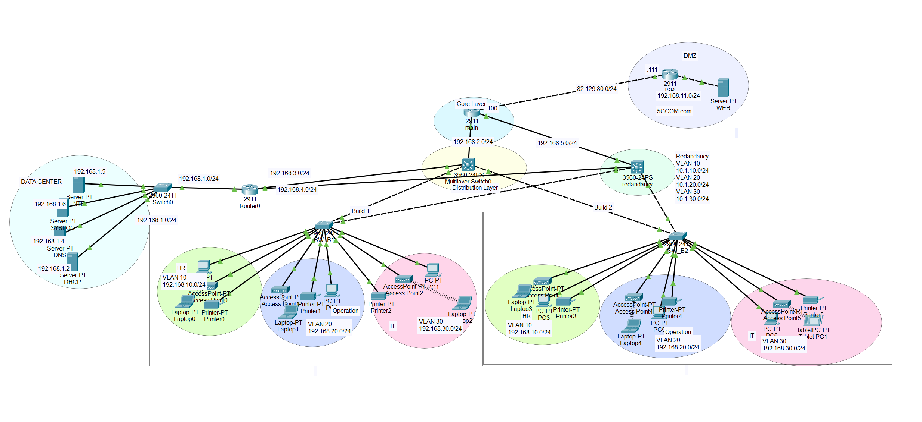
Block Diagram

Slide 7
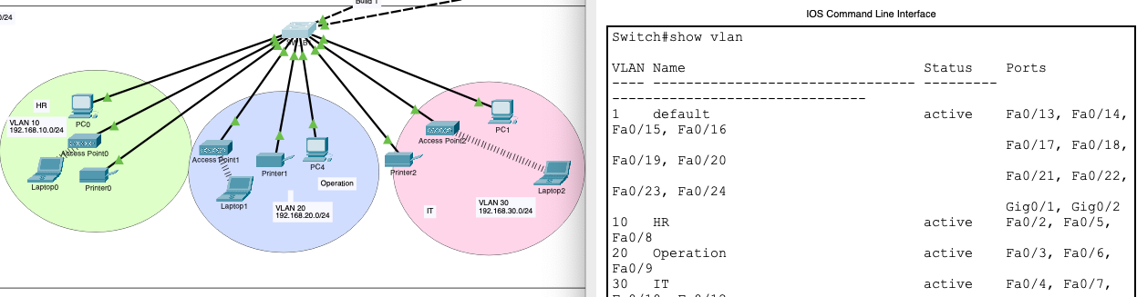
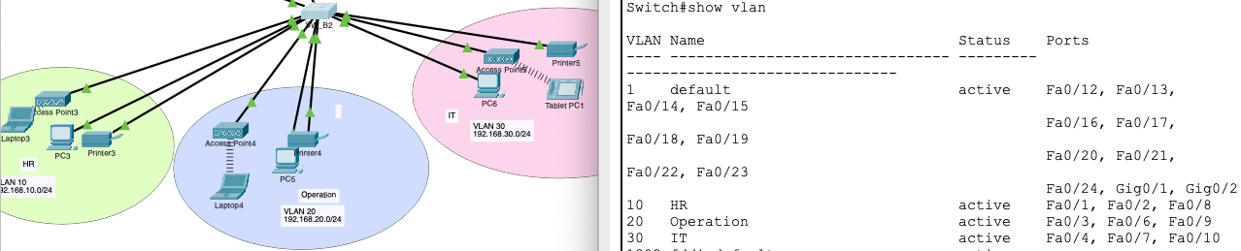
VLAN Configurations
Build A
Build B

Slide 8
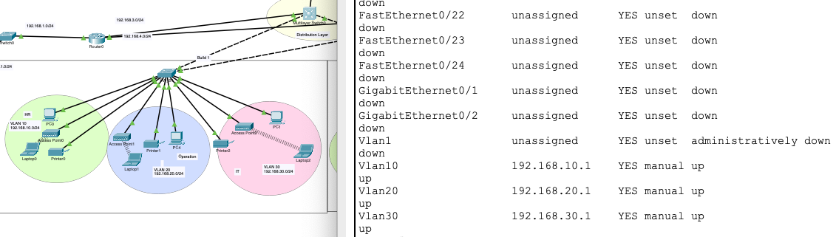
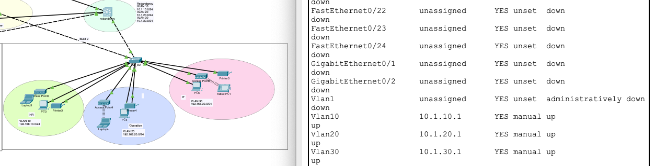
Inter-VLAN Configuration
Multi-layer Switch 1
Multi-layer Switch 2

Slide 9
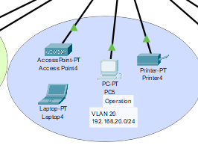
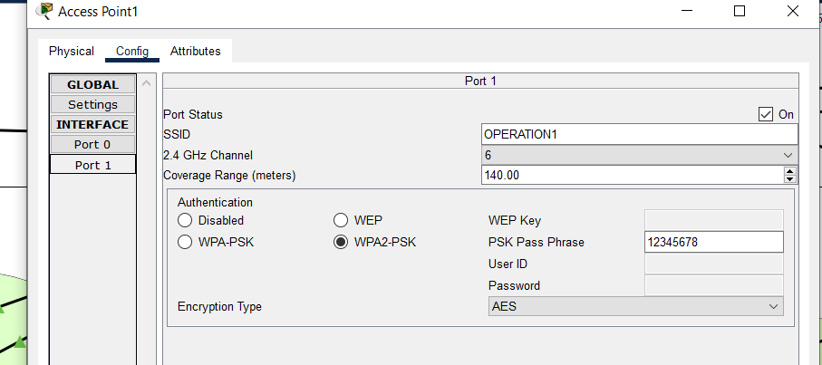
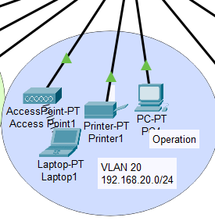
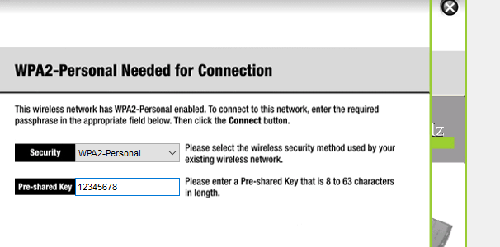
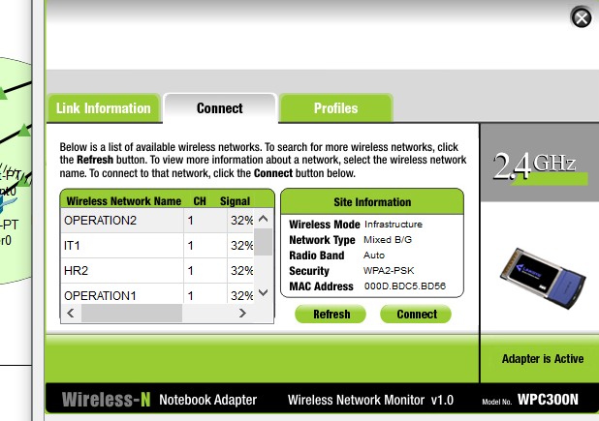
Access Point
It serves as a central point for providing connectivity between wireless devices (such as smartphones, laptops, and printers) and the wired network.
Placement: Ensure proper placement to maximize coverage.
Configuration: Use management tools to set security and access parameters.
Testing: Test the range and signal strength.

Slide 10
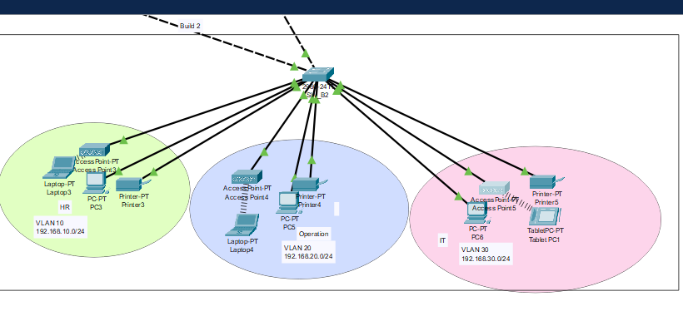
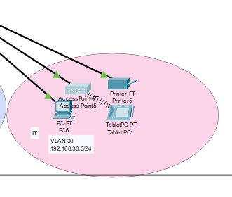
Common Uses
Home
To provide wireless internet access throughout the home.
Offices
To facilitate access to the network and shared resources.
Public Areas:
Such as cafes and airports, to provide internet access for visitors.

Slide 11
Servers

Slide 12
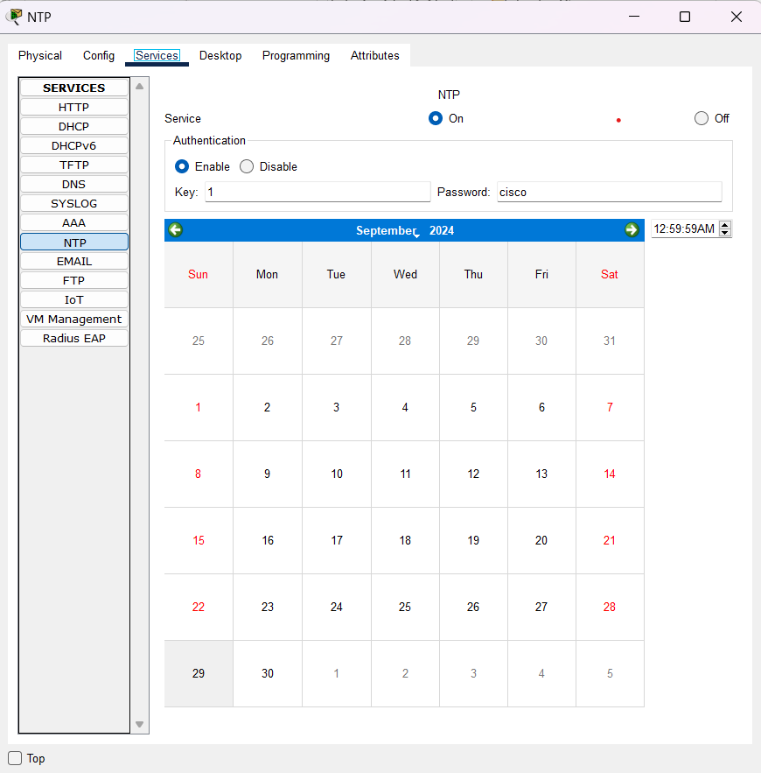
NTP Server
What is NTP:
is a protocol designed to synchronize the clocks of computers or network devices over a network.
Steps to Configure NTP Server:
R1(config)# ntp server 192.168.1.5
R1(config)#ntp authentication-key 1 md5 cisco
R1(config)#ntp trusted-key 1
R1(config)#ntp server 192.168.1.5 key 1
R1(config)# ntp authenticate

Slide 13
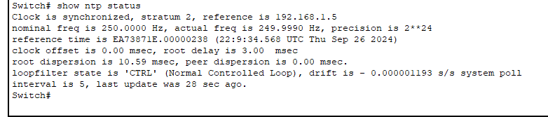
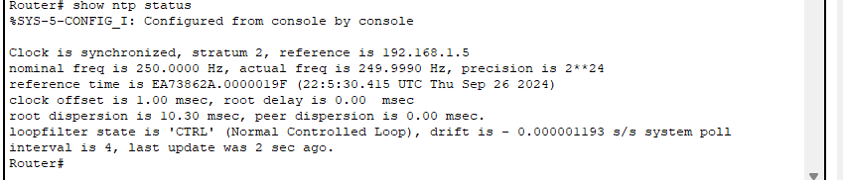
NTP Status in Main & Multilayer_SW0
Multilayer Switch0
Main Router

Slide 14
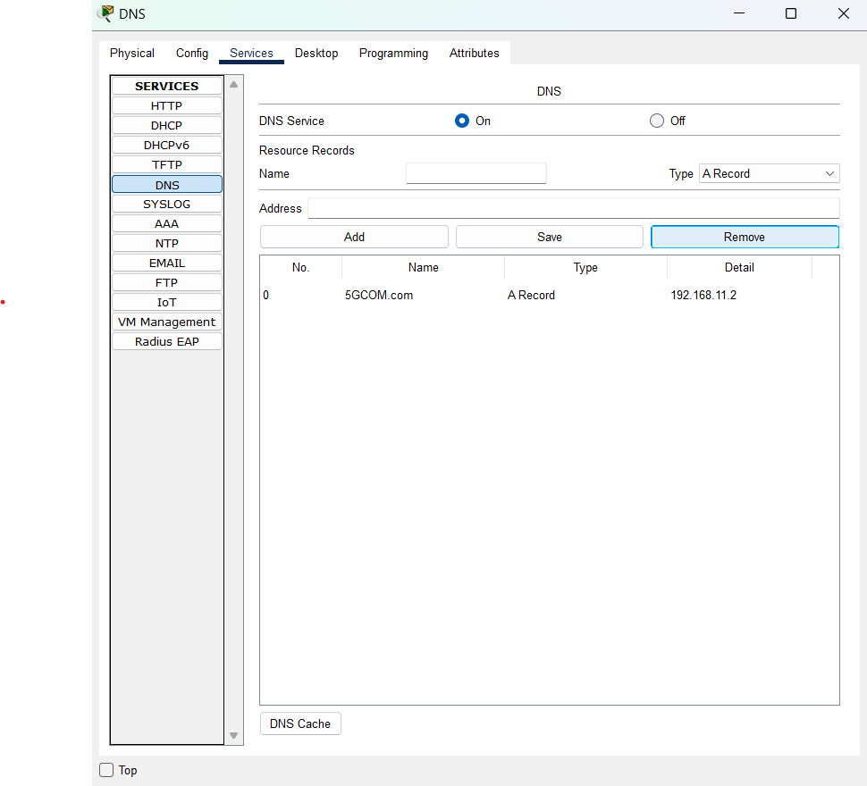
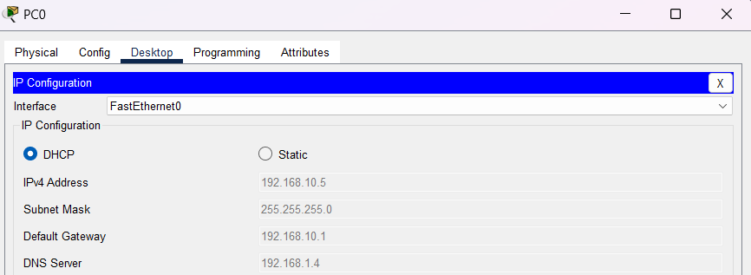
DNS Server
What is DNS?
DNS (Domain Name System) is like the phonebook of the internet.
It translates human-readable domain names (e.g., 5GCOM.com) into IP addresses (e.g., 192.168.11.2).
Configuration :
Click on the server to open the configuration window.
Go to the "Services" tab.
From the left menu, select DNS.
Turn DNS Service ON (ensure the button is green).
Under "Name", enter the domain name you want to resolve ( 5GCOM.com ).
Under "Address", enter the corresponding IP address of the website (e.g., 192.168.11.2 for PC1 or another device that will host the web service).
Click Add to save the record.

Slide 15
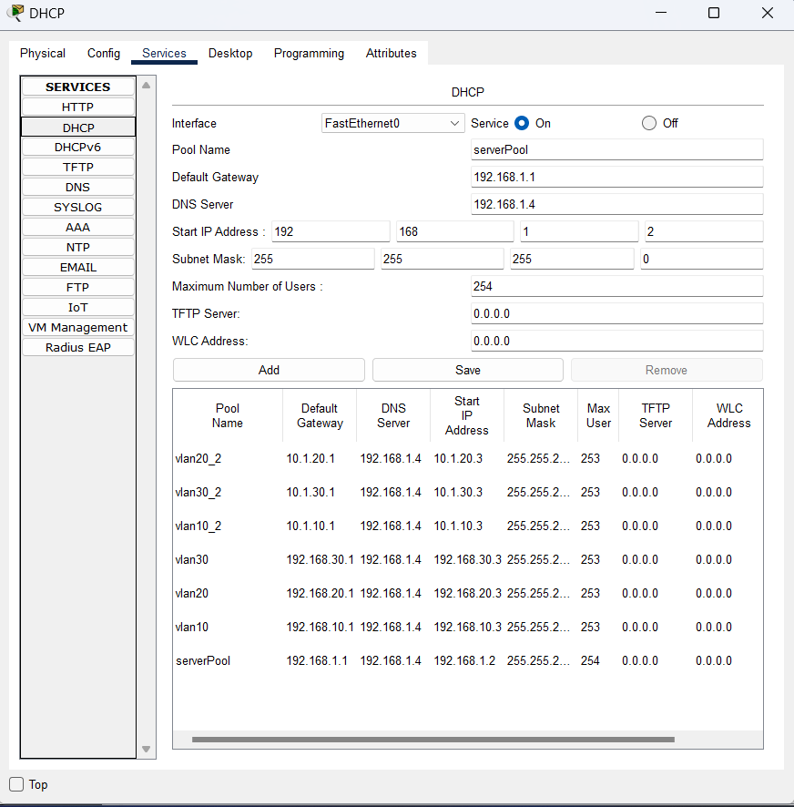
DHCP Server
What is DHCP?
DHCP stands for Dynamic Host Configuration Protocol, a network management protocol used to automatically assign IP addresses and other configuration settings to devices on a network.
Steps to Configure DHCP Server:
IP DHCP pool [name ]: Creates a DHCP pool on Cisco devices.
Configure Gateway : Assign default gateway and DNS settings.
Configure DNS-Server [DNS IP]: Specifies DNS server for clients
Network [IP/subnet]: Specifies the range of IP addresses to assign.
Click Add to save
Start the DHCP Service.

Slide 16
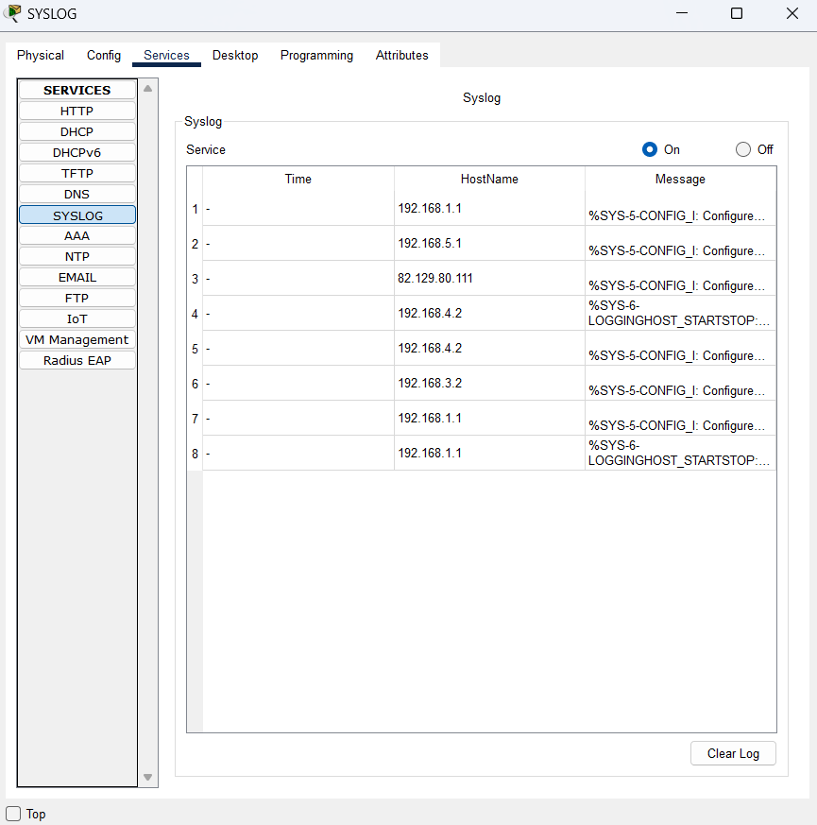
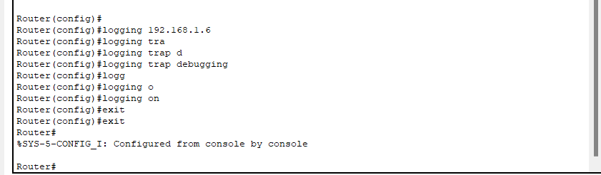
Syslog Server
What is Syslog?
Syslog (System Logging Protocol) is a standard protocol used to send and receive log messages from various network devices and servers.
Configure the Router :
Click on the Router to open its configuration window.
Go to the CLI tab to access the command-line interface.
Enter the following commands to configure Syslog logging on the network device:
enable
configure terminal
logging host 192.168.1.6
logging trap debugging
logging on
exit

Slide 17
Protocols

Slide 18
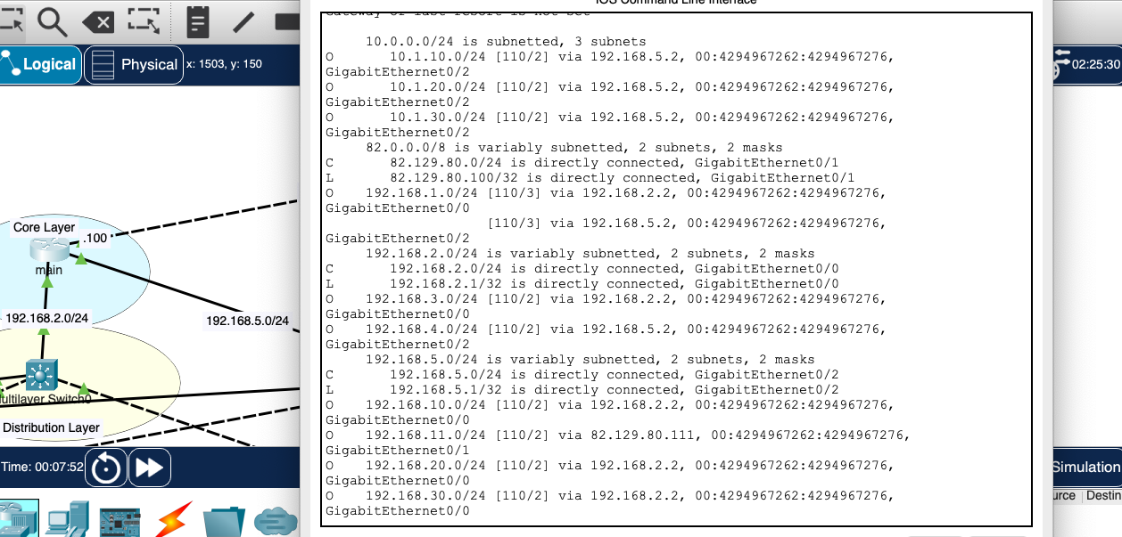
OSPF Routing
OSPF Routing protocol
Result in main router
OSPF Configuration
Routing table
Enable OSPF with process ID
Define the networks and assign them to areas

Slide 19
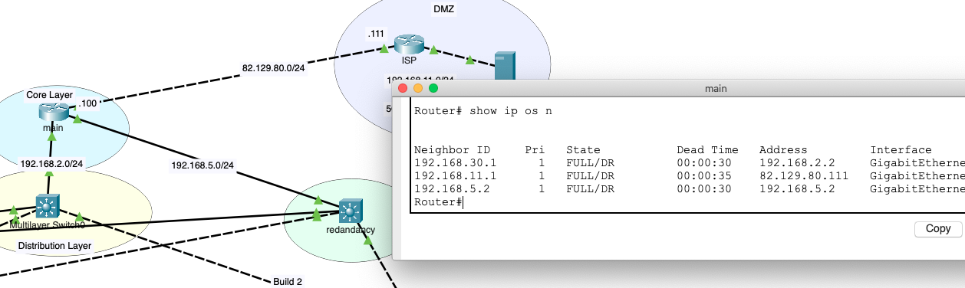
OSPF Routing
OSPF Routing protocol
Result in main router
OSPF Configuration
OSPF neighbor

Slide 20
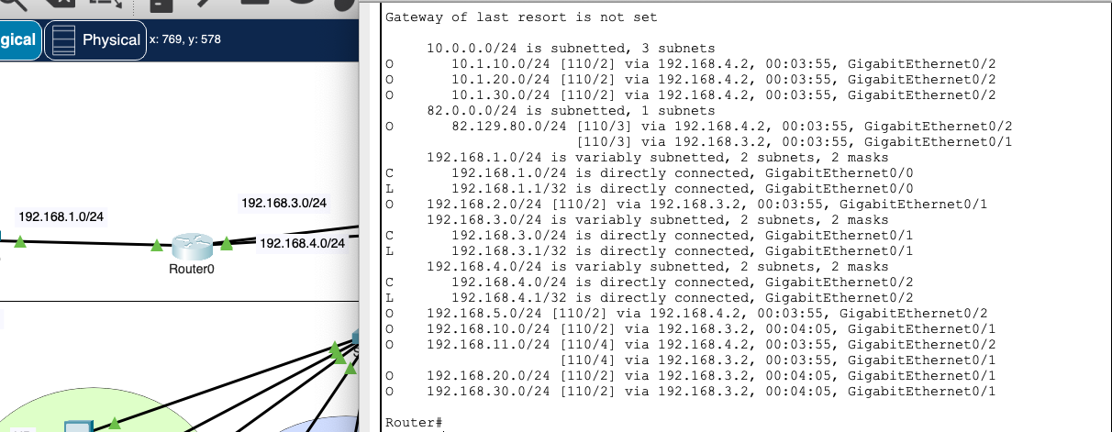
OSPF Routing
OSPF Routing protocol
Routing table
OSPF Configuration

Slide 21
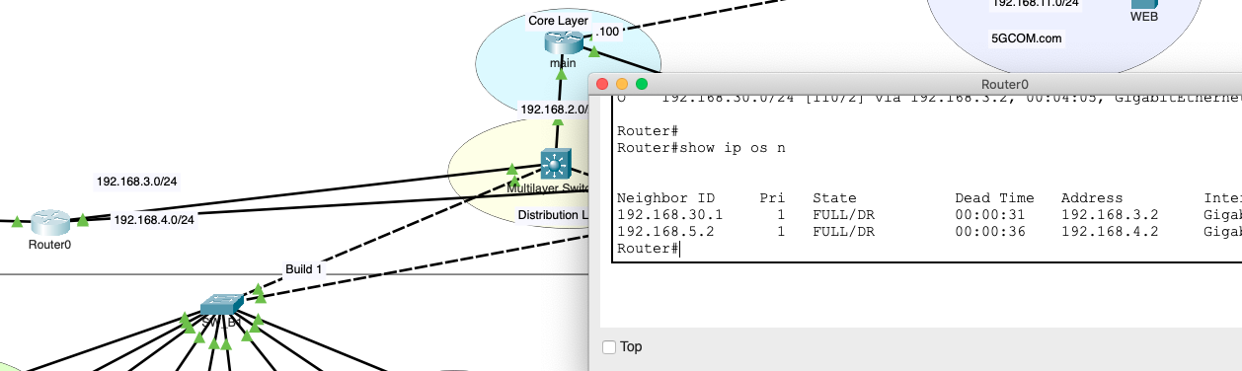
OSPF Routing
OSPF Routing protocol
OSPF Configuration
OSPF neighbor

Slide 22
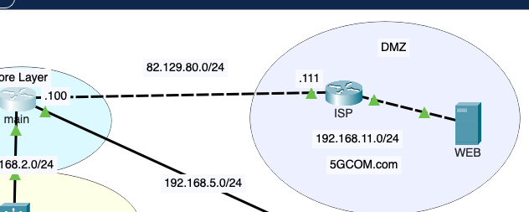
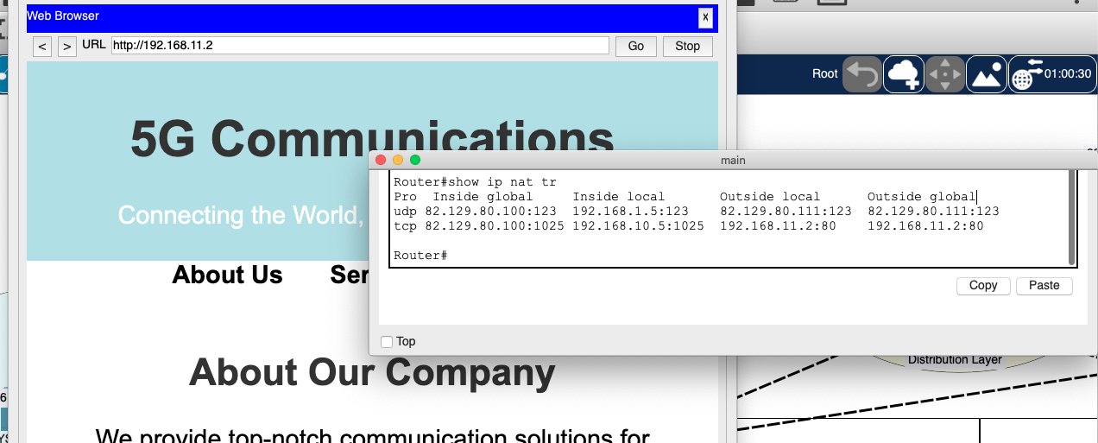
NAT
NAT Protocol
Port Address Translation (PAT)

Slide 23
Security

Slide 24
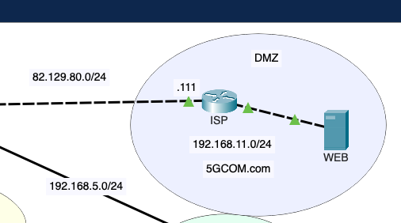
DMZ
A DMZ (Demilitarized Zone)
Setup Works in a DMZ
Web server is assigned a private IP (192.168.11.2) in a dedicated DMZ zone, separated from the internal LAN.
The server offers public-facing services (HTTP on port 80 in this case), accessible to external users but not directly connected to the internal network.

Slide 25
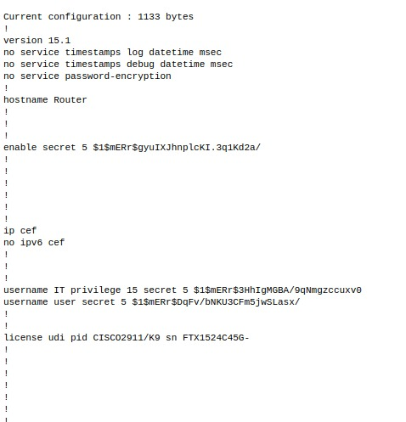
Router Password Configuration and Network Login
Local Password Authentication
Local Password Setup: configured local password authentication to secure router access. This method involves creating a password directly on the router for users trying to log in through a console and also used the secret command, which provides encrypted storage of the password.
Privilege Levels
Routers have 16 different privilege levels (0–15), with level 15 being the highest level, providing full administrative access.
Enable secret
The enable secret is used to move from user EXEC mode (privilege level 1) to privileged EXEC mode (privilege level 15).
I configured the enable secret to allow authorized users to elevate their privileges after logging in.

Slide 26
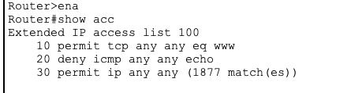
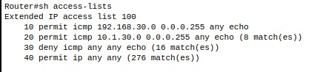
Access Control Lists (ACLs)
ACLs are used to filter traffic in a network based on specific conditions. There are two main types of ACLs in network security:
Standard ACLs and Extended ACLs.
Both serve different purposes and offer different levels of control over the traffic passing through a network device.
ACL main router
We configured an Extended IP Access List (ACL) on the router to enhance network security and manage traffic more efficiently.
ACL Router0

Slide 27
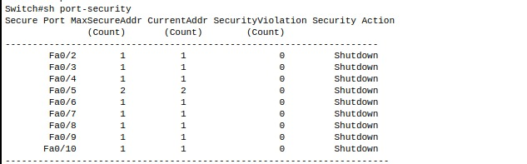
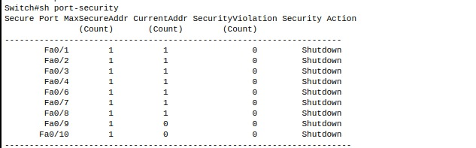
Port Security
It prevents unauthorized access and enhances network security.
Key Features:
1. Limit Devices
2. MAC Address Types
3. Violation Actions:
Protect: Blocks unauthorized devices, but keeps the port active.
Restrict: Blocks devices and sends a warning.
Shutdown: Shuts down the port if an unauthorized device connects (most secure option).

Slide 28
Thank You

